Slide 1
COMP 90018 Mobile Computing Systems Programming
Tutorial on Android Development
Chu Luo, Ransi De Silva
chu.luo@unimelb.edu.au
ransidesilva@gmail.com

Slide 2
Welcome!
Outcomes of this tutorial:
Learn to use – Github (via Android Studio)
Android UI Design and Control
Background Task: Service

Slide 3
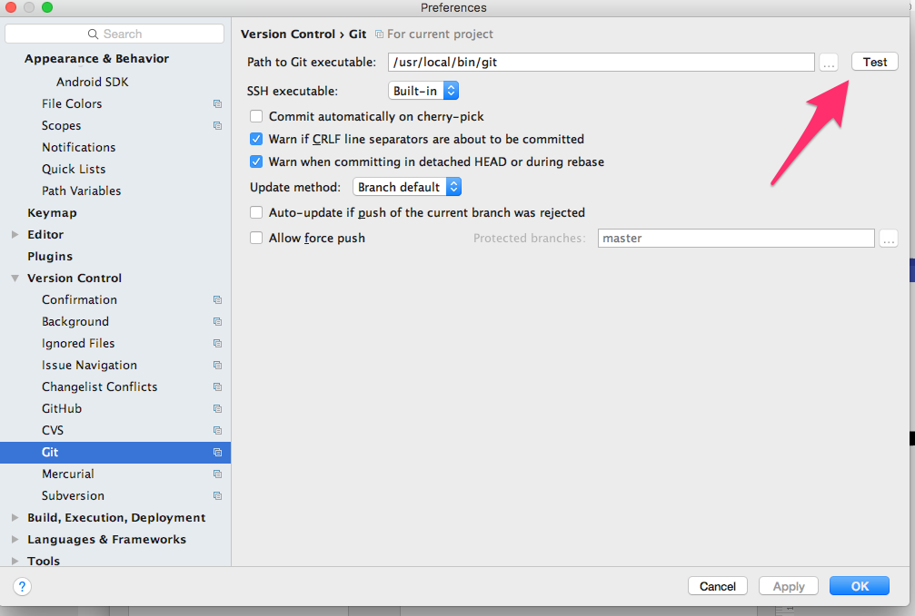
1. Github with Android Studio
Install git and create a GitHub account, then connect GitHub account to Android Studio.
git in Mac OS

Slide 4
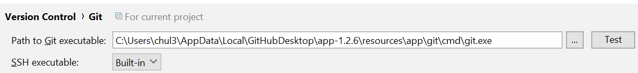
Github with Android Studio
Windows has a git.exe in a naive path if you install Github

Slide 5
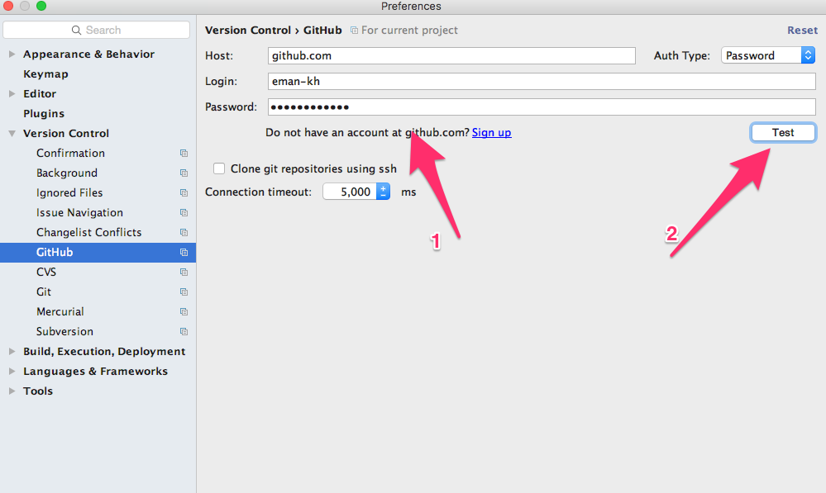
Login to your GitHub Account, go to ‘Preferences’ –> ‘Version Control’ –> ‘GitHub’.

Slide 6
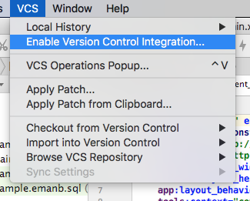
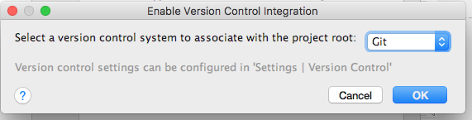
Enable Version Control Integration
Select ‘VCS’ –> ‘Enable Version Control Integration…’ to enable version control for the current project. Then, choose the version control system for your project.

Slide 7
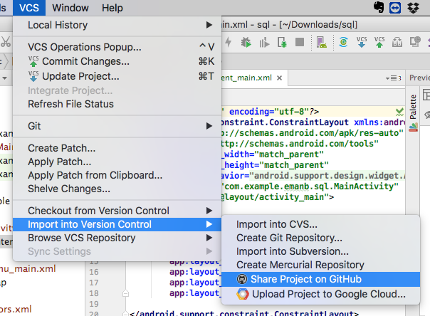
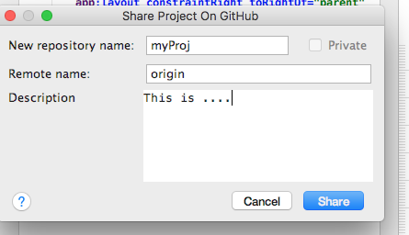
Share project on your VCS
Go to ‘VCS’ –> ‘Import into Version Control’ – > ‘Share Project on GitHub’ for creating a repository on GitHub.
Choose a repository name for your project.
An automated dialog will allow you to add files for the initial commit.

Slide 8
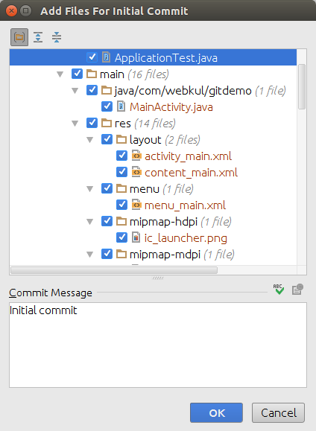
Clicking Share performs a git commit to do an initial local commit, and then a git push to push those contents to the remote repository that you created.

Slide 9
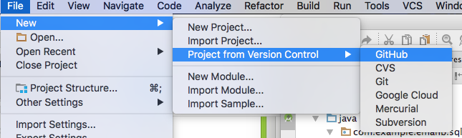
Clone an existed project from GitHub
Go to the GitHub page and get the HTTPs path to your repository. Add it.
It looks like: https://github.com/*.git
Then enter your github username and password.Select the repository and hit clone.

Slide 10
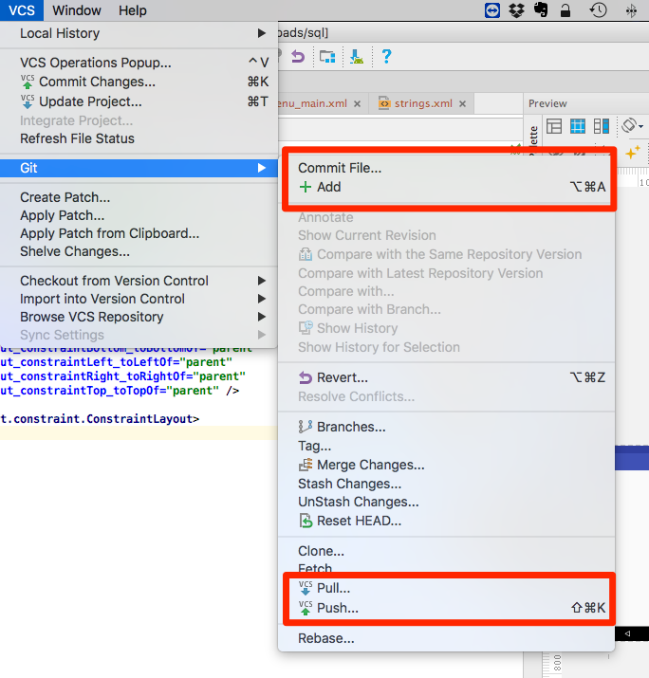
Git commands: add, commit, push, pull/Fetch, merge, branch, checkout.
Important
Never push changes to remote before you fetch and merge and resolve the conflict (manually if needed).

Slide 11
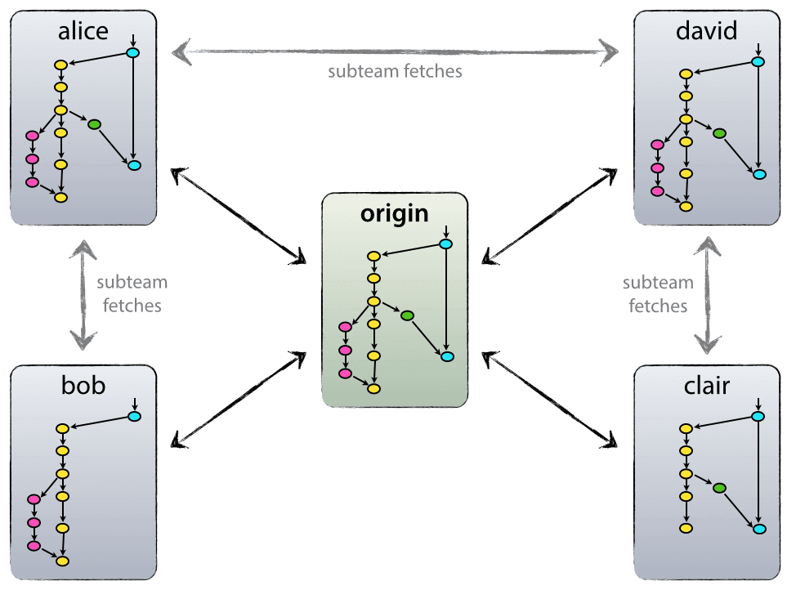
Git branching model

Slide 12
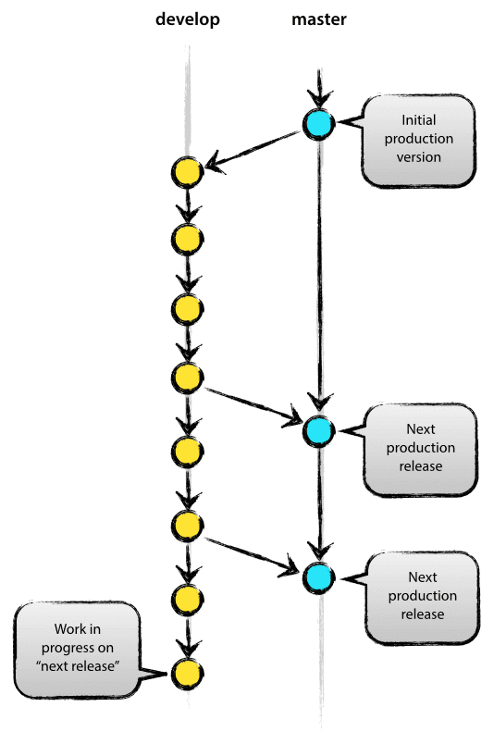
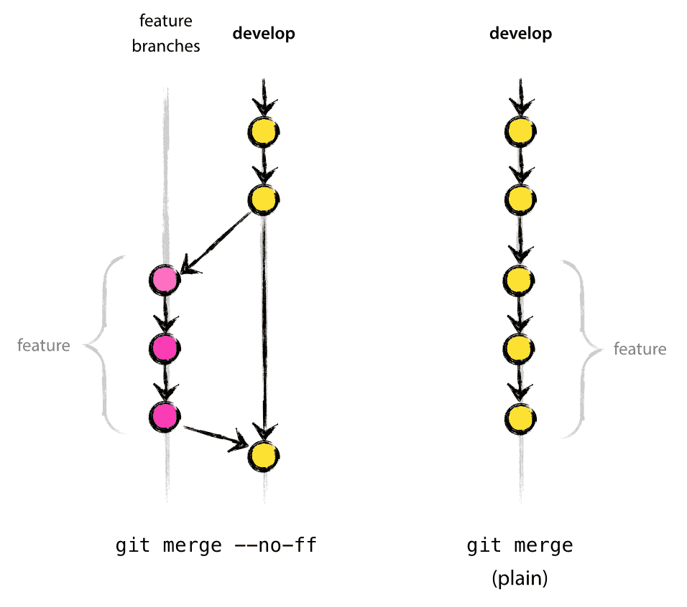
main branches
Supporting branches

Slide 13
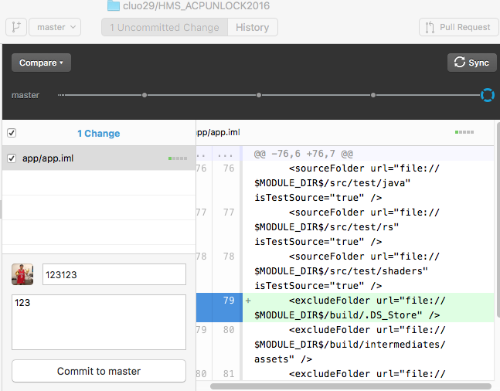
Don’t like Android Studio? Just use Github directly!

Slide 14
IMPORTANT!
Don’t rely on Github only. It may have bugs or server crashes.
Duplicate your files (every version) on your disk, cloud storage ( e.g., Google Drive)

Slide 15
Demo: Github Android Studio

Slide 16
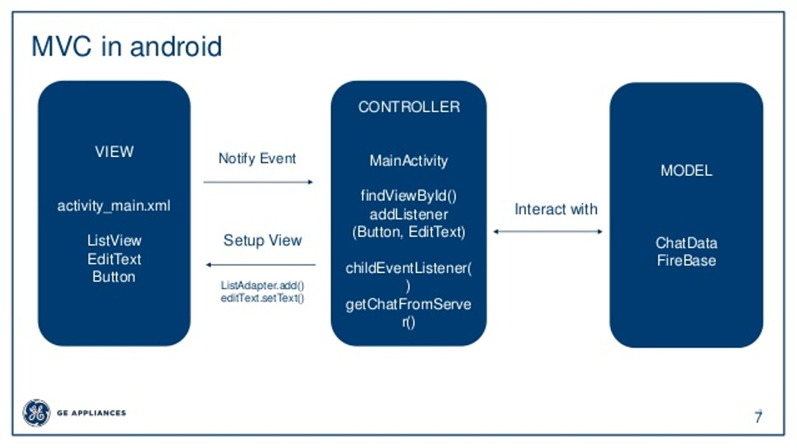
2. Android UI Design& Control
UI
Java
Network/Storage

Slide 17
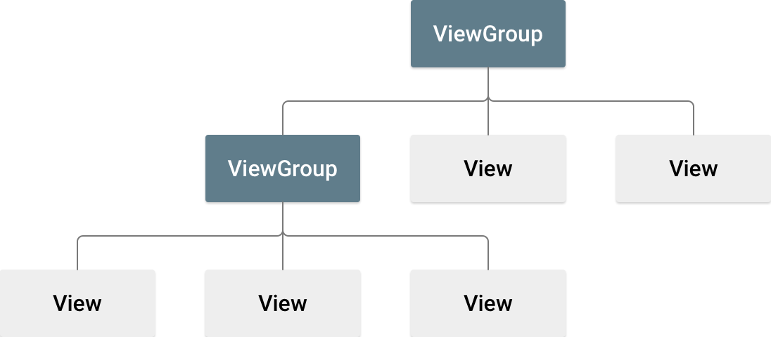
Android UI
a.k.a. Layout
Buttons, text, image windows

Slide 18
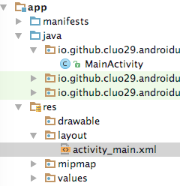
Android UI
Described by XML Files

Slide 19
Layout structures UI items

Slide 20
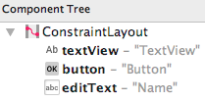
E.g., ConstraintLayout

Slide 22
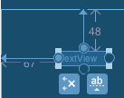
Change Position using Blue thingy

Slide 23
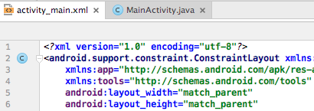
Alternatively, write XML directly

Slide 24
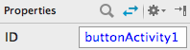
Still, give a good ID for each item

Slide 25
Exercise: 1. Put a textView, editText and button in an activity UI. 2. Input text in editText and press button, the textView shows the text. (Search Google for examples & Help)

Slide 26
Demo: UI Design

Slide 27
Advanced: Change UI Design from Controller (Java)

Slide 28
Android has super many UI elements
More information:
https://developer.android.com/guide/topics/ui/

Slide 29
Android has super many UI elements
LMS will give some UI coding examples
Fragment
ListView

Slide 30
3. Background Task: Services
Intro:
https://developer.android.com/guide/components/services.html

Slide 32
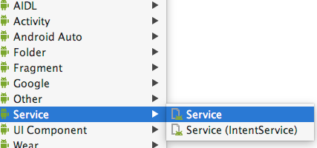
Create Service Class

Slide 33
Make it run using your Code
startService(new Intent(MainActivity.this, MyService.class));
//To stop
//stopService(MyService);

Slide 34
Service Activity Communication
Many ways. Intents are easy. Also, Intents can work as one-to-many broadcasts.

Slide 35
Send Data via Intents
Name your intent
Declare a filter within the receiving program (e.g., Activity) in Manifests file

Slide 36
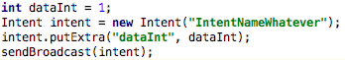
Service Sends Data via Intents

Slide 37
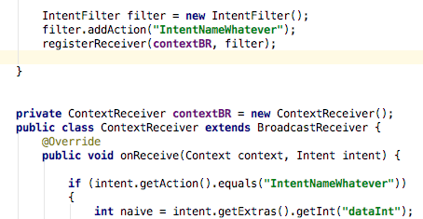
Receive Data from Intents
onCreate
Activity class

Slide 38
Demo: Unbounded Service

Slide 39
Exercise: 1. Create a Service B in an Activity A. 2. Send some data from B to A (verify received data using Log.d). 3. After receiving data, A sends some data to B (also Log.d).

Slide 40
More learning directions: 1. Design and control UI for your projects. 2. Optimise the threads. Let Service do work in a background thread.

Slide 41
What’s in next week: 1. Use multithreading in Android 2. Use sensors 3. Use localisation

Slide 42
See you next week COMP 90018
Tutorial on Android Development
Chu Luo, Ransi De Silva
chu.luo@unimelb.edu.au
ransidesilva@gmail.com

